Slide 1
TYPESCRIPT BASICS FOR AZLE CANISTER DEVELOPMENT
This session provides an overview of Typescript basics for Azle Canister development. It covers topics such as; What are Canisters and Azle in the Internet Computer ecosystem, Why Typescript and the it’s basics, setting up for Azle development among many others!!
The code and learning resources used for this presentation can be found on my GitHub:
👉GitHub Resources
LET’S GET STARTED 🚀

Slide 2
Session Objectives
What are Canisters in Azle development
Understand Essential TS for Azle Canister Development
Environment set-up for Azle development
What next?

Slide 3
Azle & Canisters
📕 Azle is a Typescript and JavaScript CDK(Canister Development Kit), i.e., it’s a runtime for building applications(canisters) on the Internet Computer. Learn More💡
🥫 Canisters: Theses are just computational “units” containing your program code to be executed on the IC chain. Learn More💡

Slide 4
Basic Typescript for Azle Development
This TS & JS datatype is decoded to text in Candid
TS/JS arrays are decoded to vec type while objects to Record type
Used as bool as a Candid type
string
number
boolean
float
Array & Object
Decoded to Candid type nat
Decoded to either float32 or float64 in Candid

Slide 5
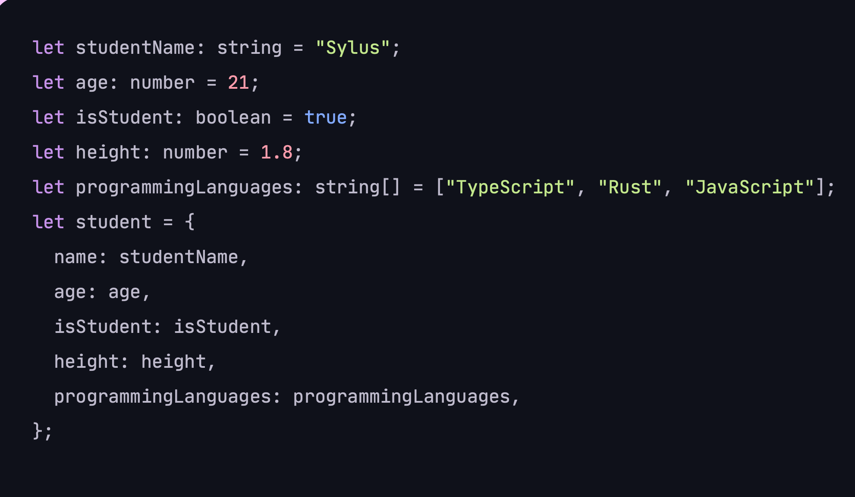
Datatypes in Typescript

Slide 6
Query Method
In Azle, Query methods, also functions are created using the query keyword. Query methods are used to expose a canister’s functionalities.
Learn More💡
The first parameter describes the Candidtypes used for argument in your query method.
The second is a CandidType object used to encode the return value of your function to
The third parameter to query is the function that receives the decoded arguments, performs some computation, and then returns a value to be encoded.

Slide 7
Update Method
Update methods, also functions are like query methods, but they enable state changes to be persisted. The syntax is basically the same the following code shows an example.
The method defined above when called will return and increment the value of counter which is a global variable. Thus, any subsequent query method will have access to an update counter variable.

Slide 8

Stable Structures
In Azle there’re two kinds of memory the Heap and Stable memory. The concept of heap memory stores global variables that are wiped when the canister code is re-built. Stable structures are used to access the stable memory in IC(i.e. memory that persists atomically over canister updates.
Azle currently provides one stable structure called StableBTreeMap. It's similar to a JavaScript Map and has most of the common operations you'd expect such as reading, inserting, and removing values.chain. Learn More💡

Slide 9
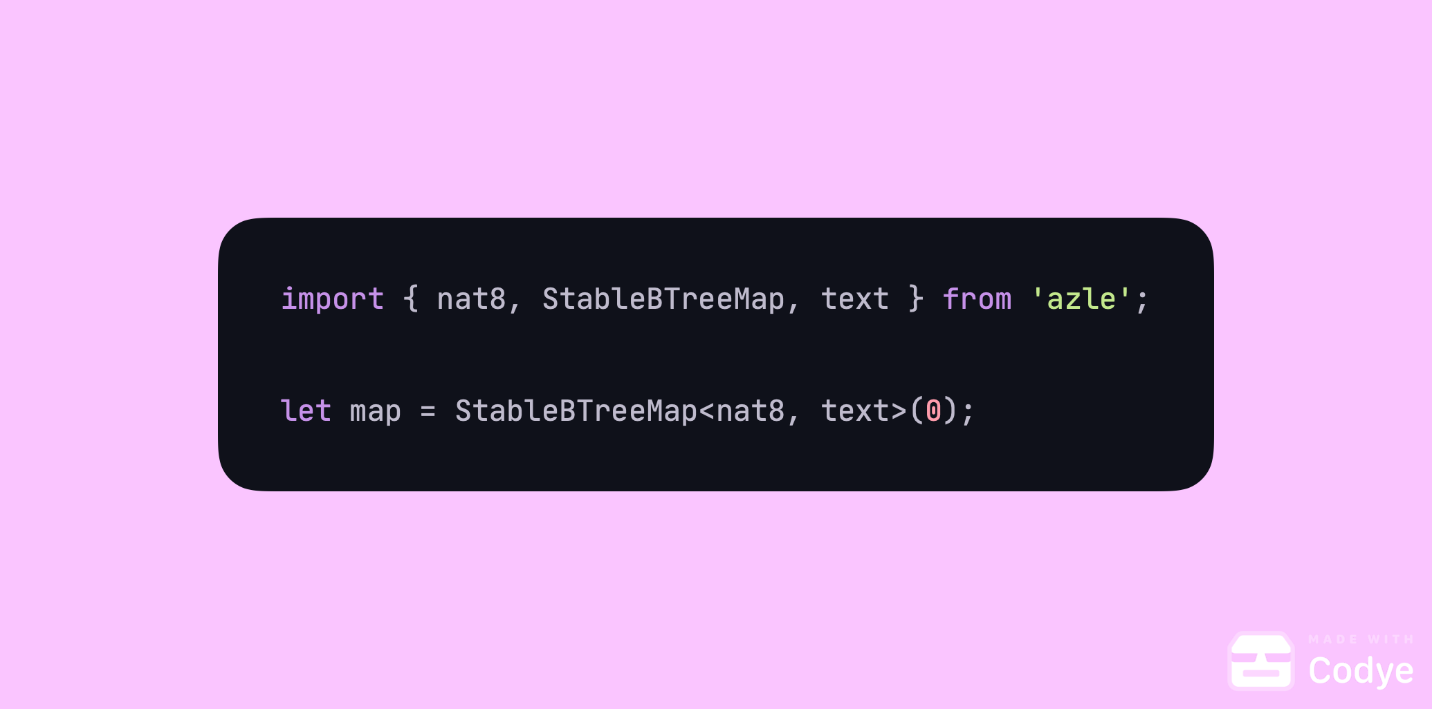
StabelBTreeMap
This is a StableBTreeMap with a key of type nat8 and a value of type text. It also has a memory id of 0. Each map should have a memory between 0 – 254.
Since it’s similar to the Map in JS, we can StableBTreeMap shares methods such as get, insert, contains among others with the Map functionality of JavaScript.

Slide 10
LET’S BUILD SOMETHING
Set up Azle Environment
Simple Hello World
Advanced Tutorial
Takeaways & Next steps

Slide 11
Summary & QA
Questions?
What are the Key Takeaways?
Learning Resources

Slide 12






Useful Learning Materials
Code & State Youtube Channel
divin3circle
Azle Handbook
@Silasabel5
Learn Typescript
sylus.abel

Slide 13
Thank you for your time and attention 🙂

